Slide 1
The Surprising Nuance Behind the Russian Troll Strategy
Author: Kate Starbird
CS795/895
2019-03-27
Puneeth Bikkasandra
Old Dominion University

Slide 2
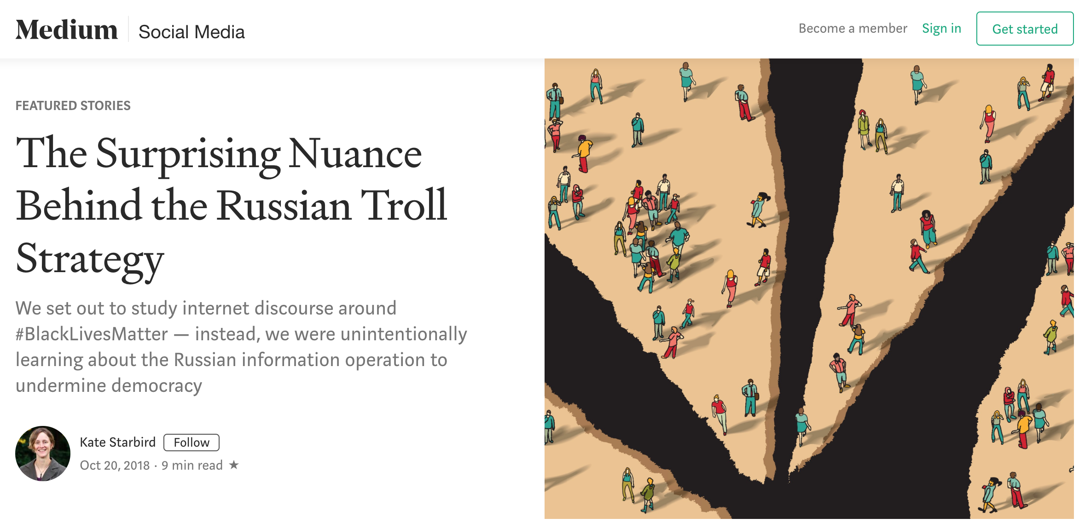
Source: https://medium.com/s/story/the-trolls-within-how-russian-information-operations-infiltrated-online-communities-691fb969b9e4

Slide 3
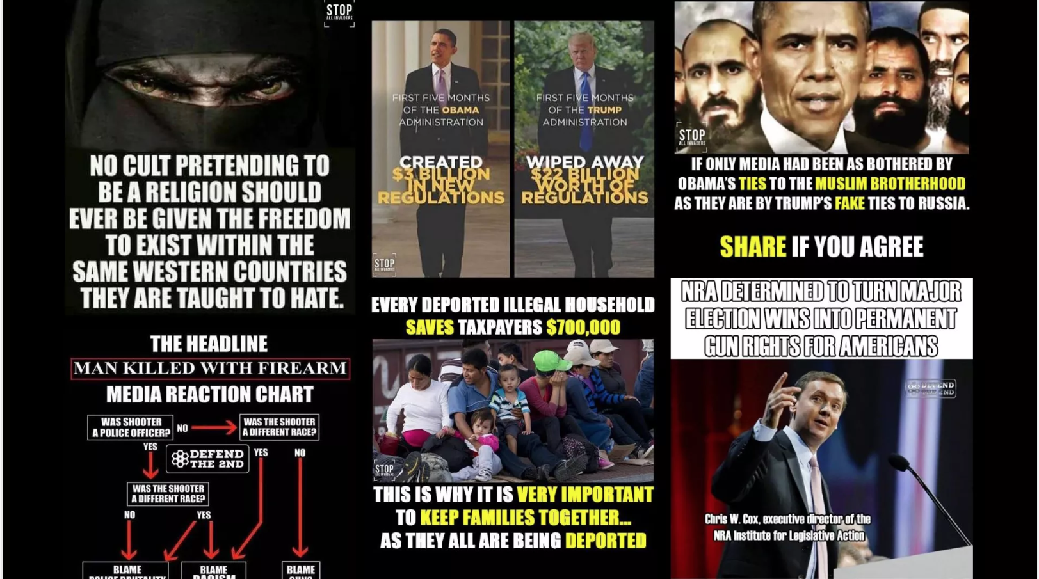
DOJ charges against Russian citizen for Election Interferences
https://www.axios.com/russian-national-charged-with-2018-election-interference-d0fae66c-3270-49f3-ab2c-b16cd870f46f.html

Slide 4
What is Information Operations?
Exploiting social media platforms to manipulate audiences for strategic and political goals
Main aim was to influence the U.S. election in 2016.
Intention being to track online conversations around the #BlackLivesMatter movement.
https://medium.com/s/story/the-trolls-within-how-russian-information-operations-infiltrated-online-communities-691fb969b9e4

Slide 5
Framing: a powerful tool.
Interpreting new information through the way we see, hear and experience.
Frames existing in individuals can be shared and will guide others in interpreting information
News, political ads, or a conversation with a friend help you understand why to vote.
Framing contests result when multiple groups attempt to promote different frames.
https://medium.com/s/story/the-trolls-within-how-russian-information-operations-infiltrated-online-communities-691fb969b9e4

Slide 6
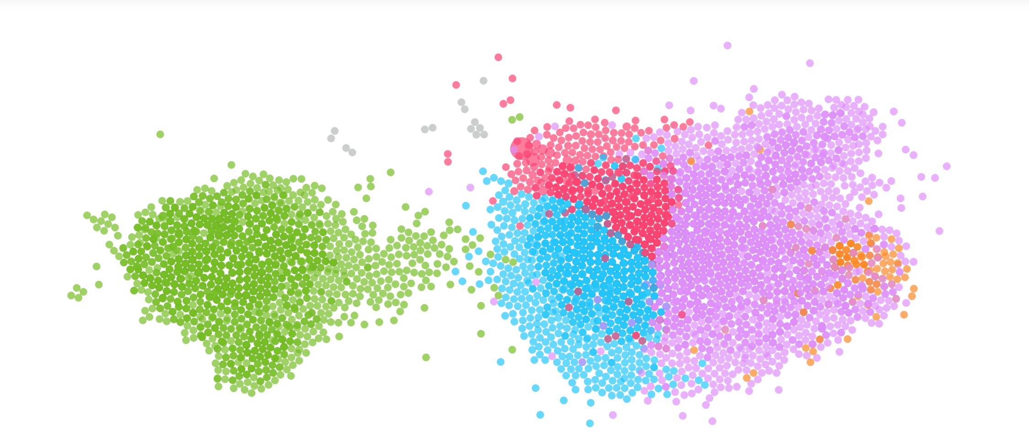
Framing contests on twitter: #BlackLivesMatter
66,000 tweets and 8,500 accounts (Supportive vs Critical)
“Shared Audience” Network Graph of Accounts in Twitter Conversations about #BlackLivesMatter and Shooting Events in 2016
https://medium.com/s/story/the-trolls-within-how-russian-information-operations-infiltrated-online-communities-691fb969b9e4

Slide 7
PRO (#BlackLivesMatter) ANTI (#BlackLivesMatter)
“Cops called elderly Black man the
n-word before shooting him to death
#KillerCops #BlackLivesMatter”
“WHERE’S ALL THE #BlueLivesMatter
PEOPLE?? 2 POLICE OFFICERS SHOT
BY 2 WHITE MEN, BOTH SHOOTERS
IN CUSTODY NOT DEAD”
“Nothing Says #BlackLivesMatter like mass looting convenience stores & shooting ppl over the death of an armed thug.”
“What is this world coming to when you can’t aim a gun at some cops without them shooting you? #BlackLivesMatter”
https://medium.com/s/story/the-trolls-within-how-russian-information-operations-infiltrated-online-communities-691fb969b9e4

Slide 8
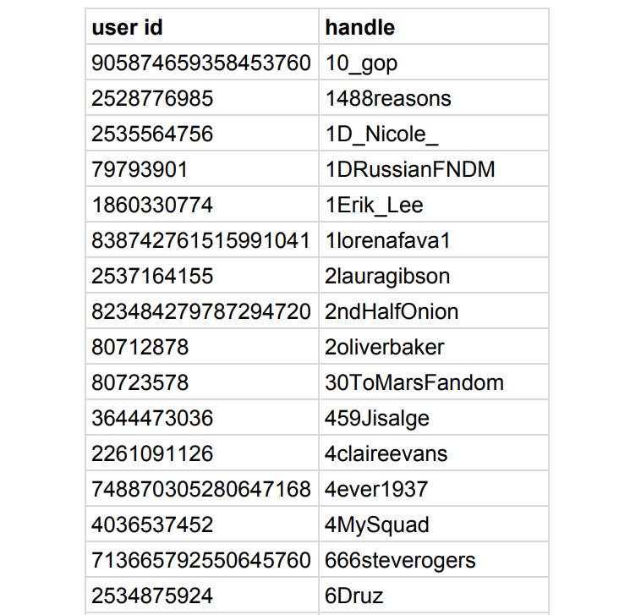
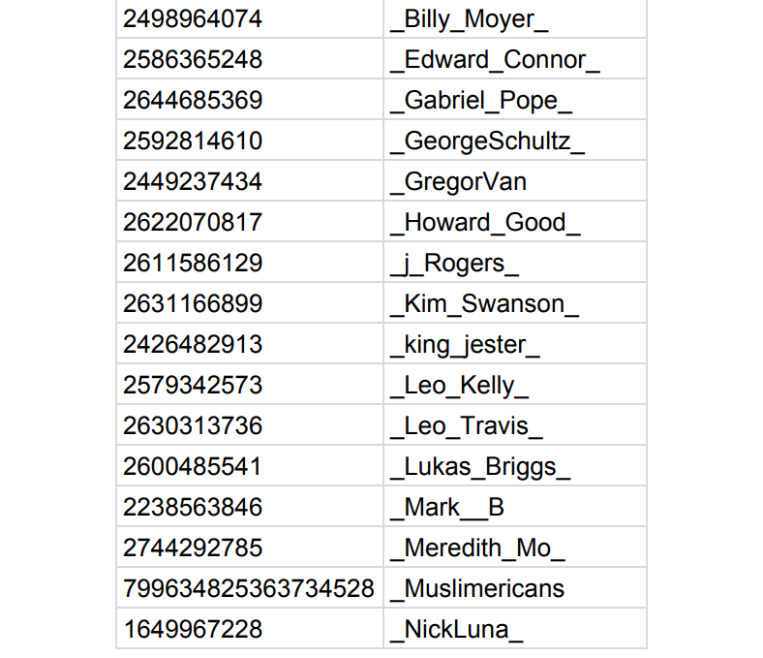
Twitter releases accounts linked to IRA
https://intelligence.house.gov/uploadedfiles/exhibit_b.pdf
https://medium.com/s/story/the-trolls-within-how-russian-information-operations-infiltrated-online-communities-691fb969b9e4

Slide 9
Analysis from #BlackLivesMatter Dataset:
@Crystal1Johnson and @TEN_GOP with most retweets.
Sensitive tweets were created by IRA accounts, not by
#BlackLivesMatter or its activists.
https://medium.com/s/story/the-trolls-within-how-russian-information-operations-infiltrated-online-communities-691fb969b9e4

Slide 10
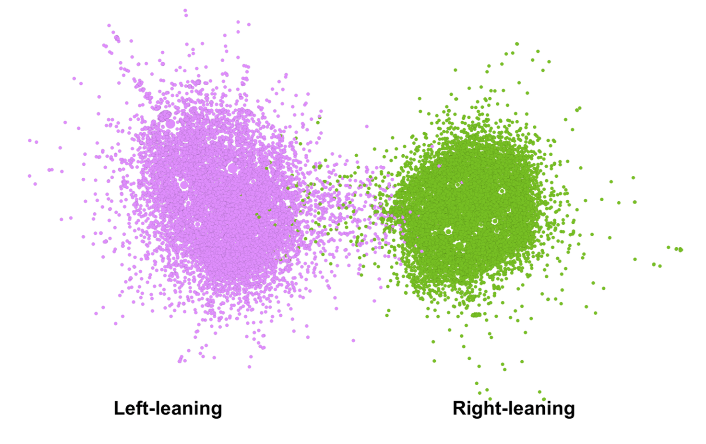
Network graph using retweet patterns from accounts
Retweet Network Graph of Accounts in Twitter Conversations about #BlackLivesMatter and Shooting Events in 2016
https://medium.com/s/story/the-trolls-within-how-russian-information-operations-infiltrated-online-communities-691fb969b9e4

Slide 11
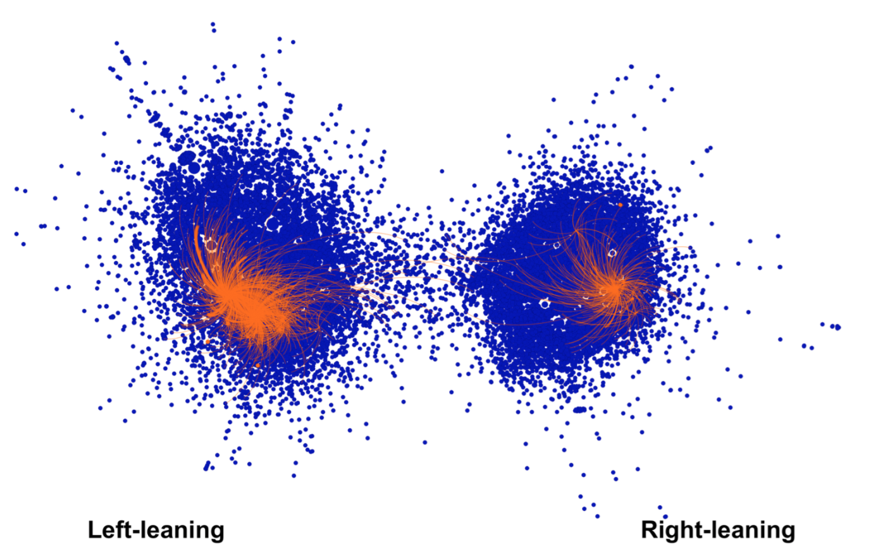
Accounts identified as IRA’s information operations
Retweet Network Graph plus IRA Troll Accounts
https://medium.com/s/story/the-trolls-within-how-russian-information-operations-infiltrated-online-communities-691fb969b9e4

Slide 12
#BlackLivesMatter
#BlackLivesMatter
@Crystal1Johnson
@gloed_up
@BleepThePolice
African-American activists
@TEN_GOP
@USA_Gunslinger
@SouthLoneStar
U.S. citizens or political groups critical of the #BlackLivesMatter movement
https://medium.com/s/story/the-trolls-within-how-russian-information-operations-infiltrated-online-communities-691fb969b9e4

Slide 13
Agenda of Information Operations:
Sneak into online communities, develop trust and gather audience.
Gained trust to be used as advantage for other goals, prepare communities for goals of the operators.
Create division and pressurize the weak areas in the society.
A divided society ceases to come together for a common understanding.
https://medium.com/s/story/the-trolls-within-how-russian-information-operations-infiltrated-online-communities-691fb969b9e4

Slide 14
Agenda (Continued)...
Prepare the communities for other strategic goals, IRA accounts on:
Right side of the graph being in support to Mr. Donald Trump.
Left side were the critics of Hillary Clinton highlighting her comments as racist and not to vote.
unique strategies on different sides of the graph with a common objective:
“Electing Mr. Donald Trump”
supporting political results that destabilize country’s strategic positions and strengthen rivals.
https://medium.com/s/story/the-trolls-within-how-russian-information-operations-infiltrated-online-communities-691fb969b9e4

Slide 15
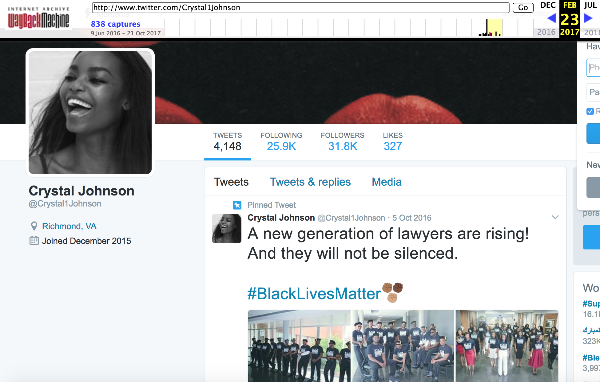
@Crystal1Johnson - Pro #BlackLivesMatter
https://web.archive.org/web/20170701000000*/www.twitter.com/Crystal1Johnson

Slide 16
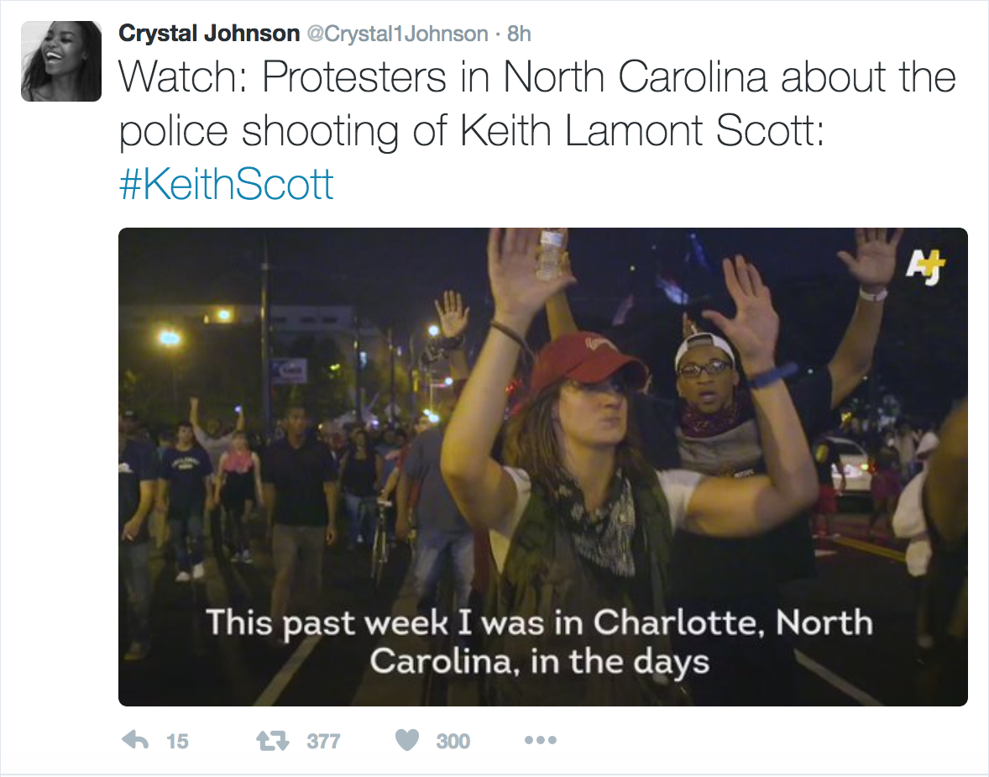
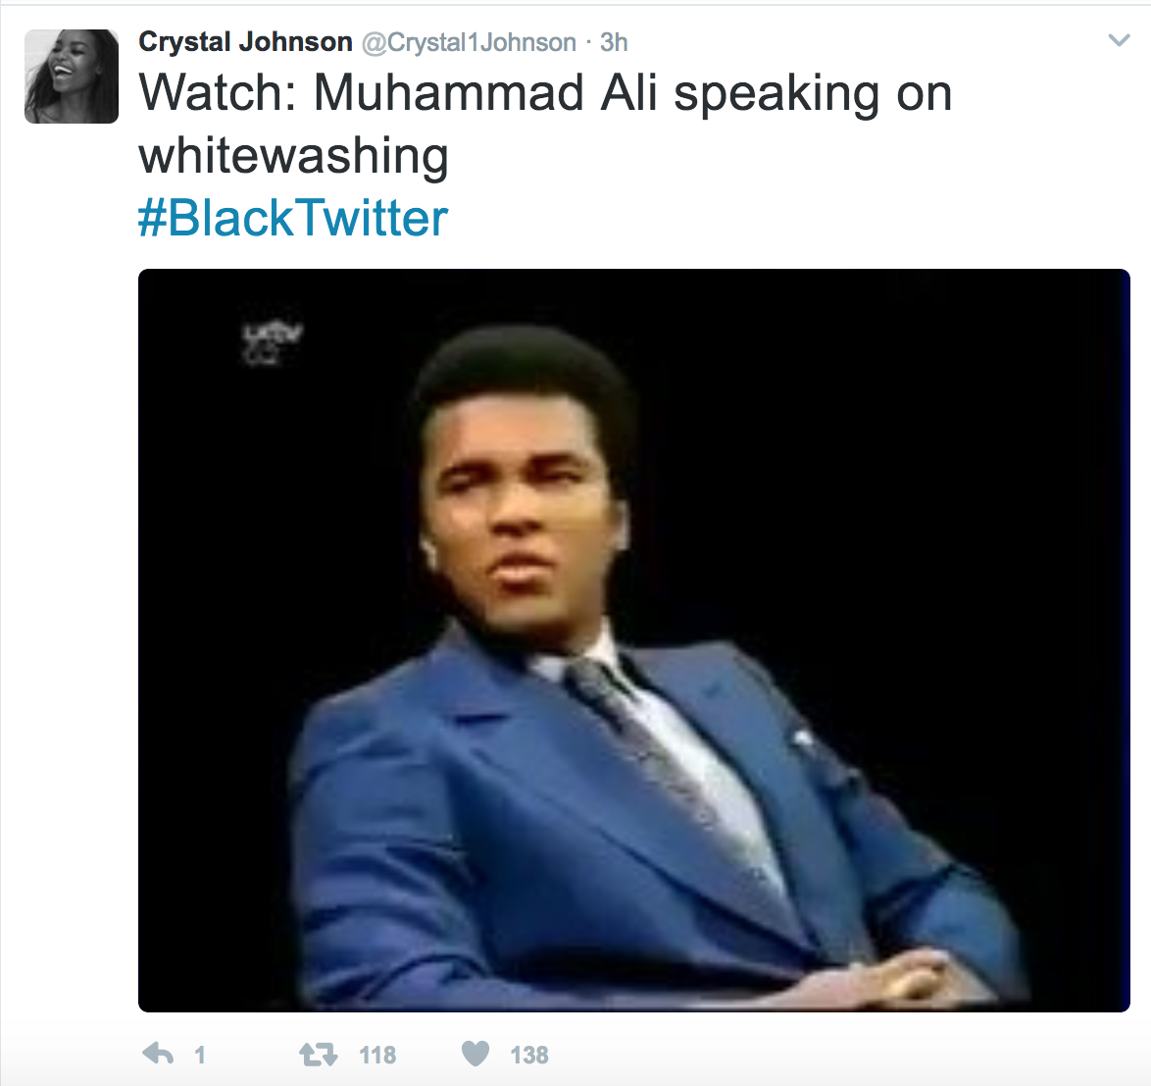
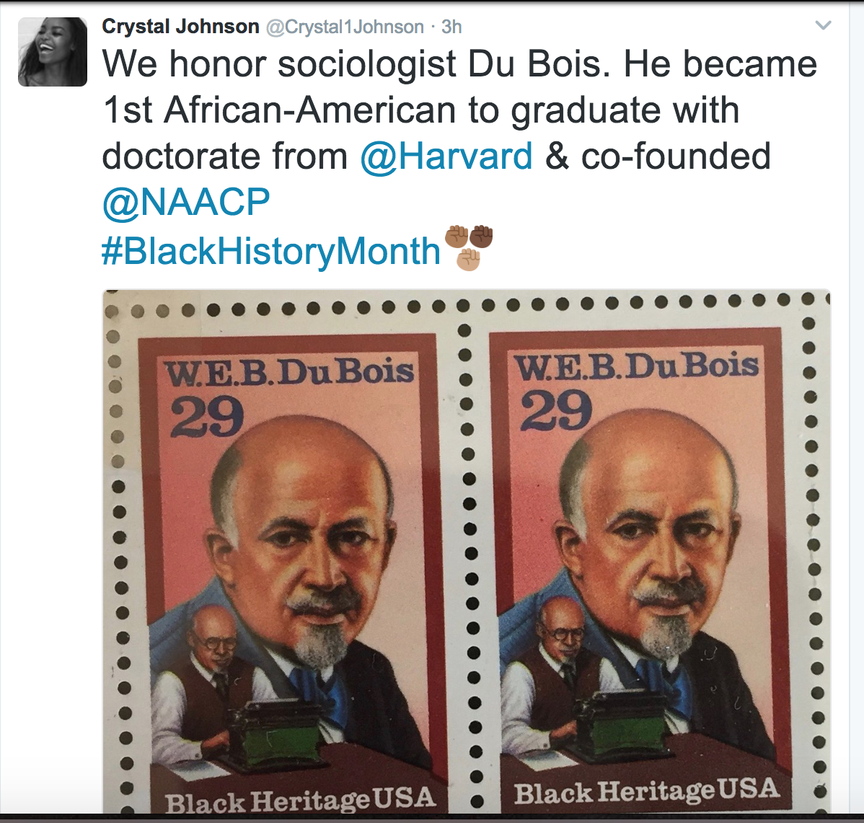
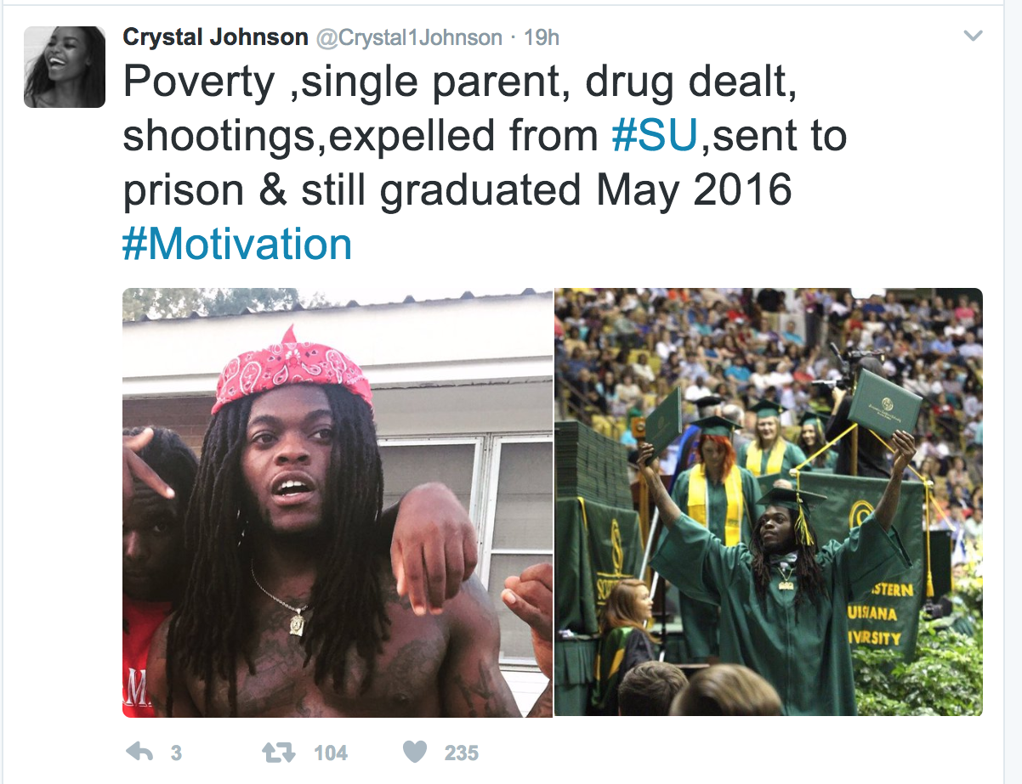
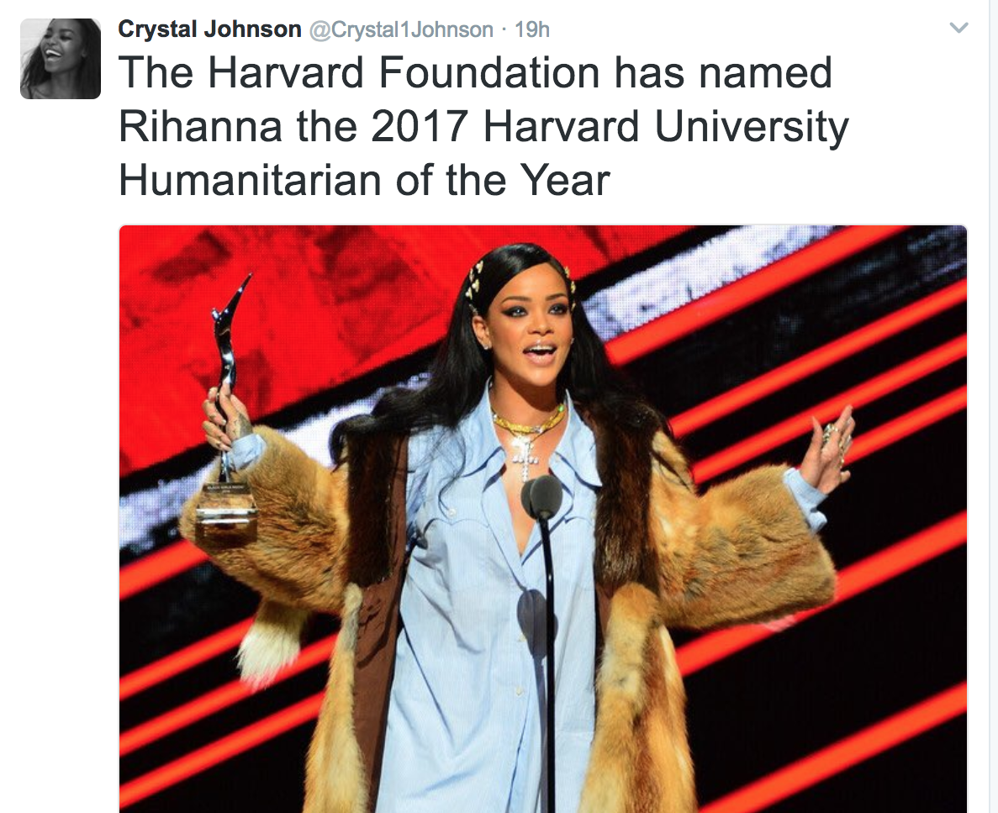
https://web.archive.org/web/20170701000000*/www.twitter.com/Crystal1Johnson

Slide 17
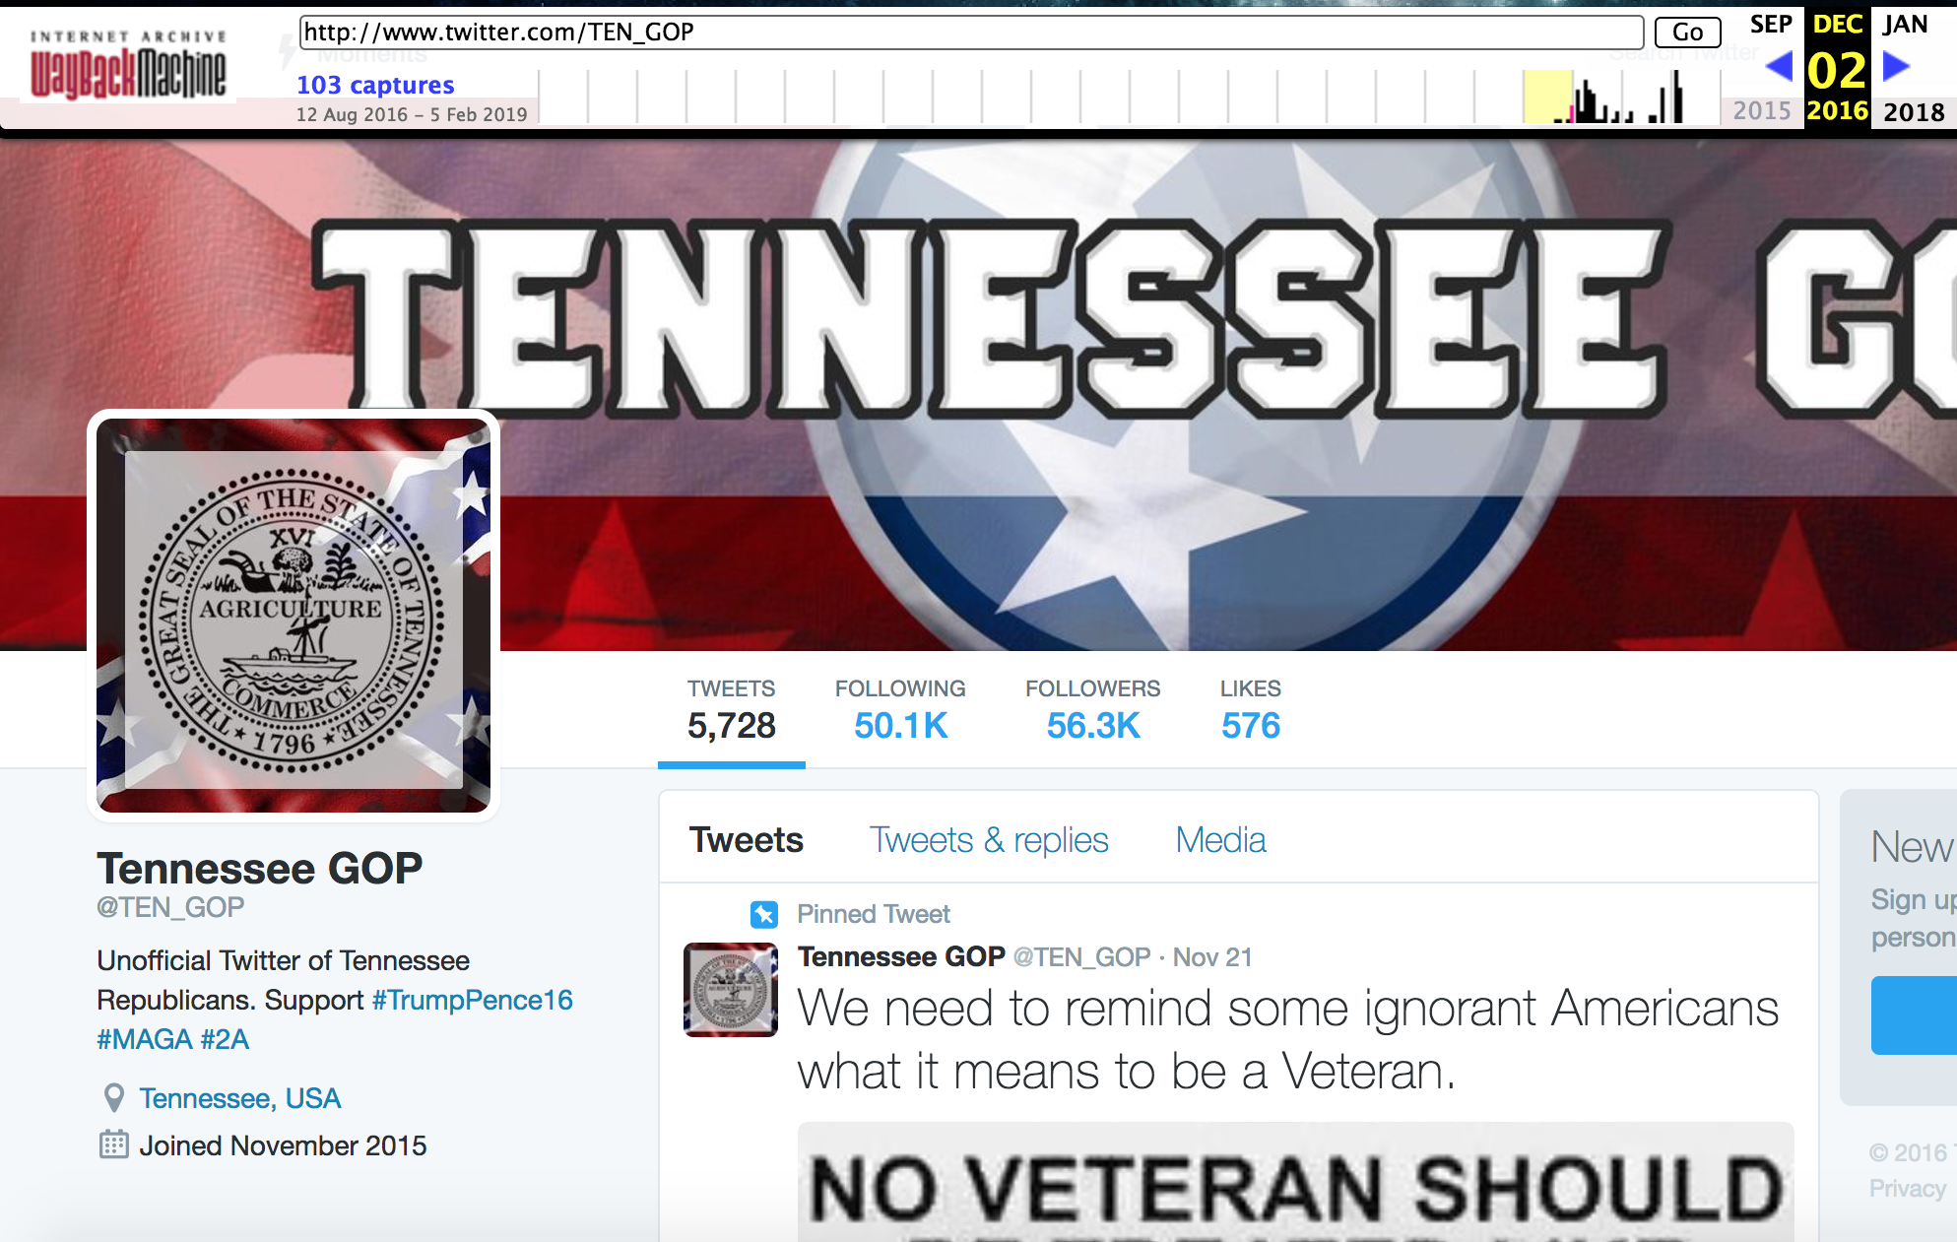
@TEN_GOP - anti #BlackLivesMatter
https://web.archive.org/web/20161202053131/www.twitter.com/TEN_GOP

Slide 18
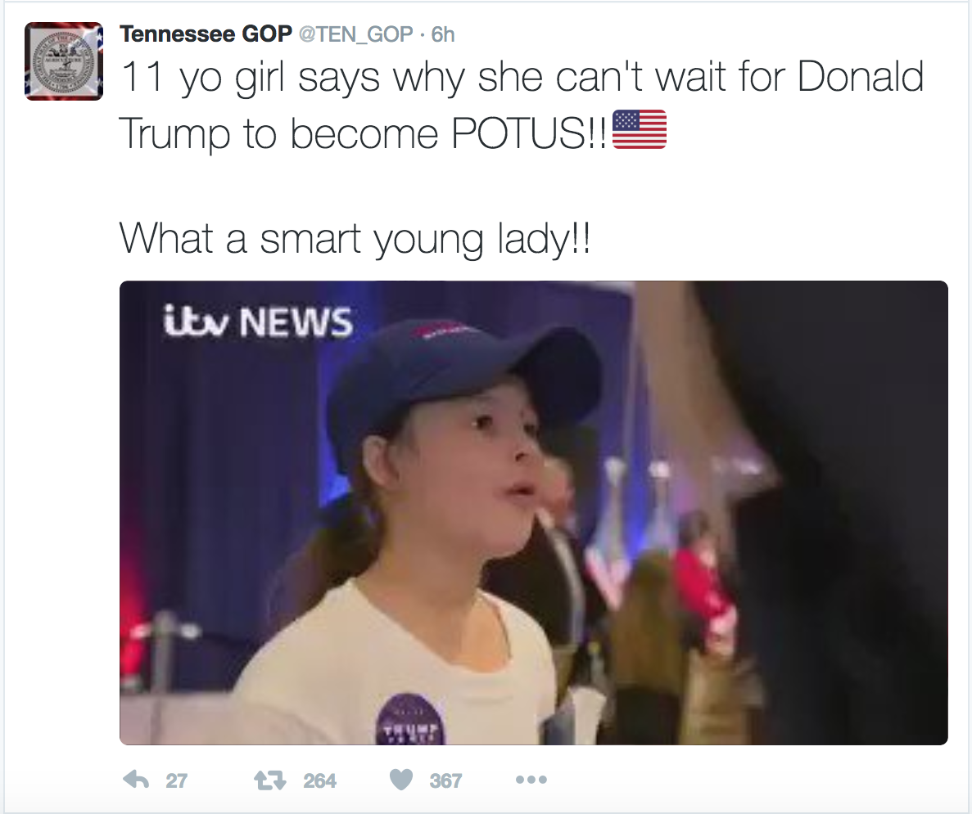
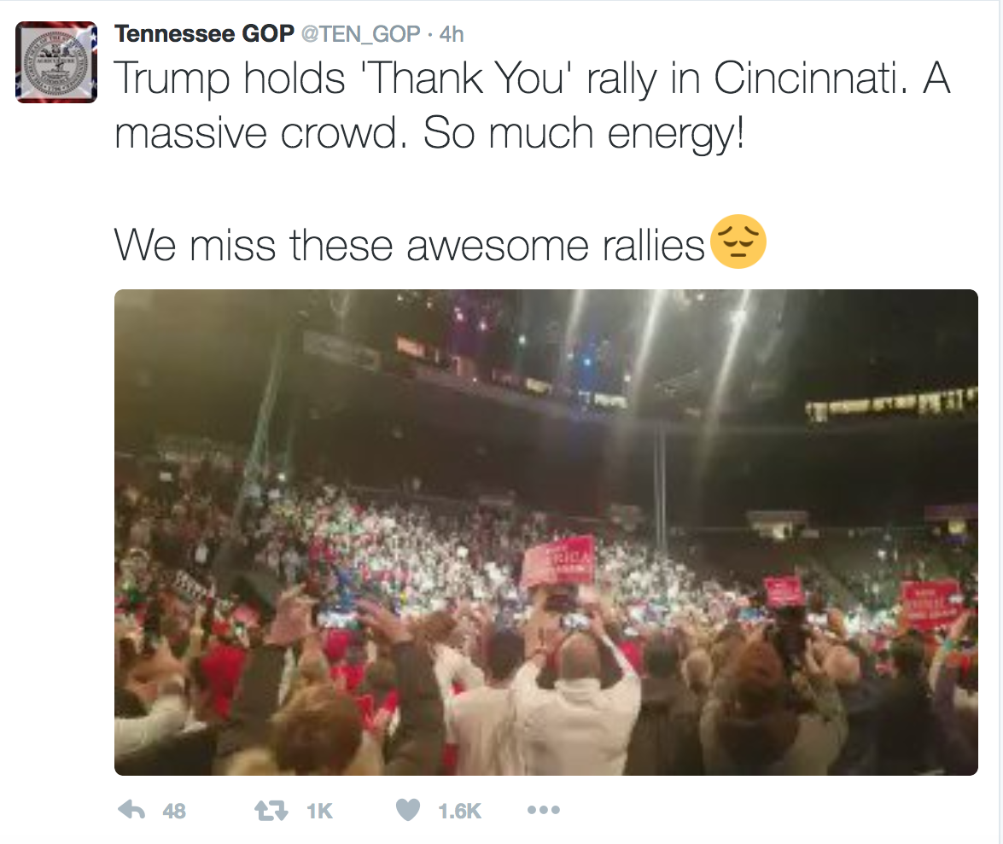
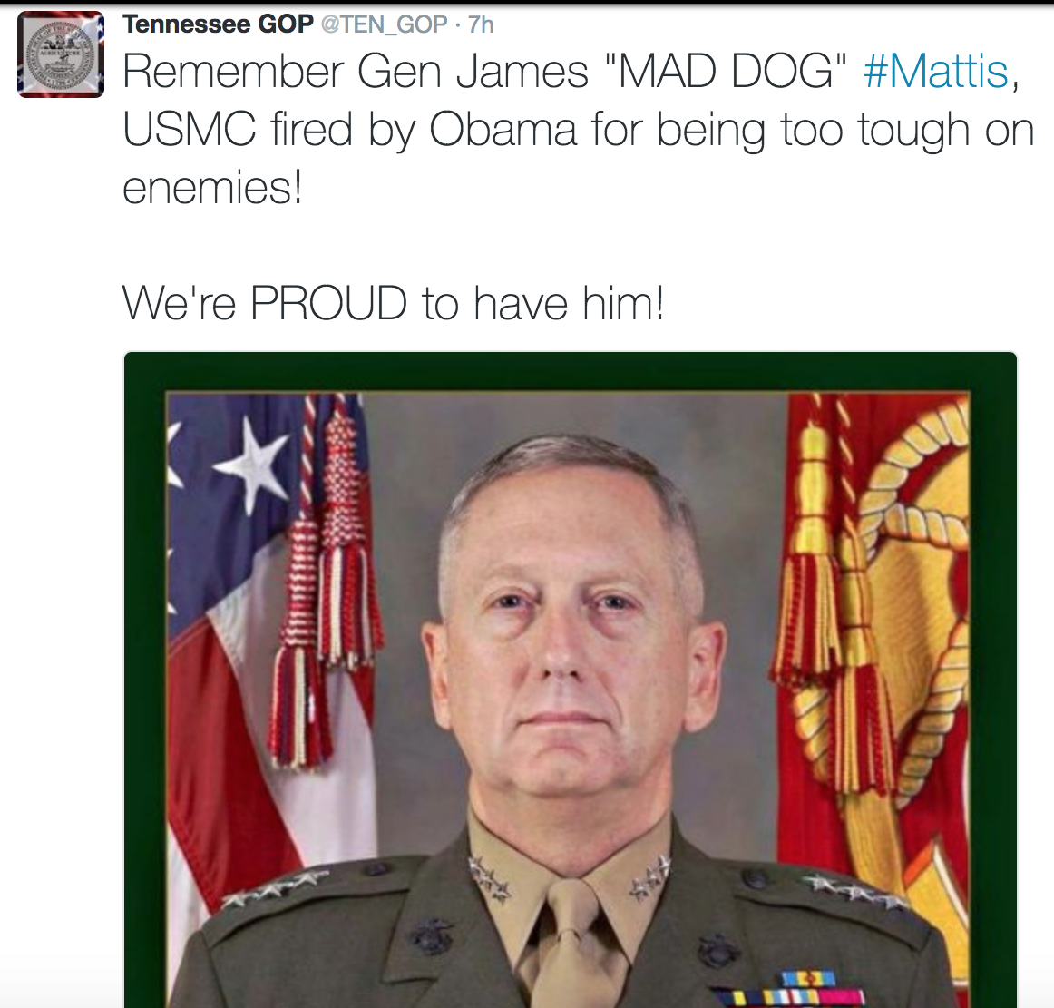
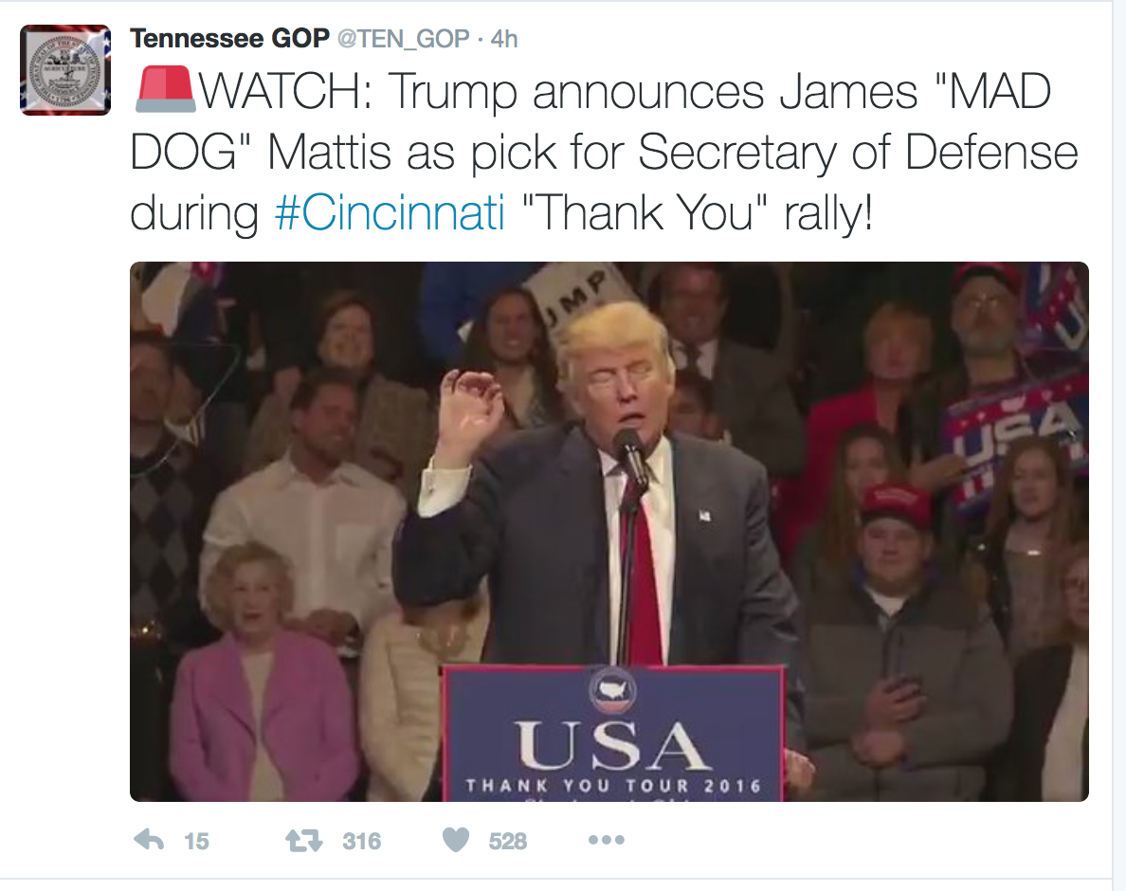
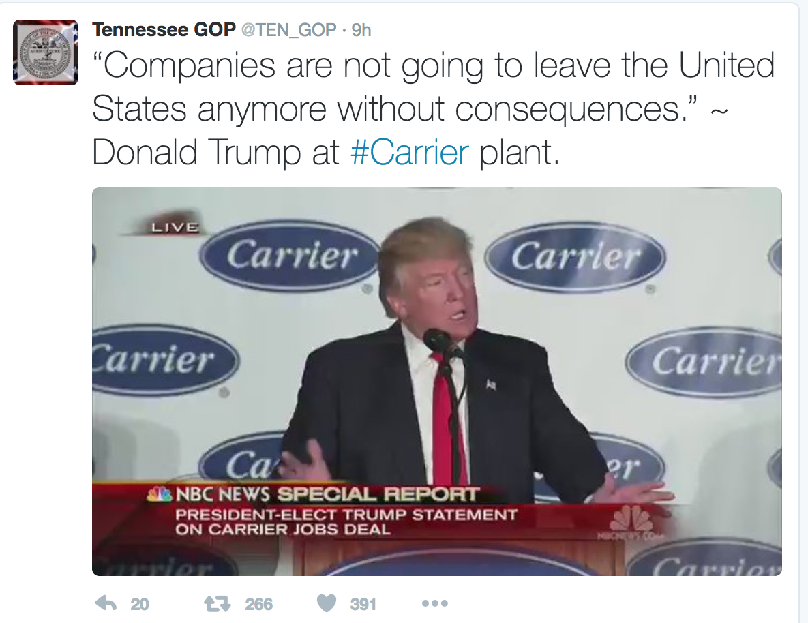
https://web.archive.org/web/20161202053131/www.twitter.com/TEN_GOP

Slide 19
Domestic (vs) International operations:
IRA accounts in Russian and English languages
Total 3667 unique accounts set to below languages:
Language | Accounts | Tweets Recorded
Russian | 1013 | 4,853,185
English | 2286 | 3,261,931
https://medium.com/@katestarbird/a-first-glimpse-through-the-data-window-onto-the-internet-research-agencys-twitter-operations-d4f0eea3f566

Slide 20
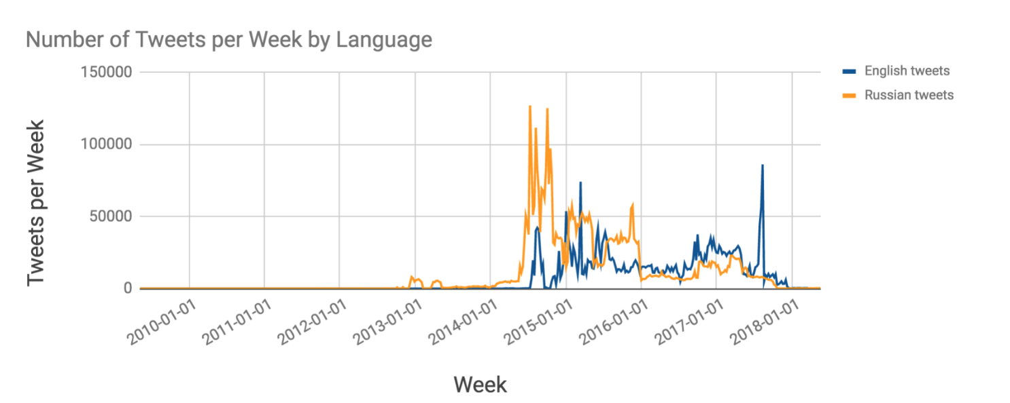
https://medium.com/@katestarbird/a-first-glimpse-through-the-data-window-onto-the-internet-research-agencys-twitter-operations-d4f0eea3f566

Slide 21
Impact through retweet numbers:
Original Tweets (IRA accounts) | Retweets (non IRA) | Total Tweets
5.7 million | 3.3 million | 9 million
Retweets in English | Total Retweets
21 million | 31 million
https://medium.com/@katestarbird/a-first-glimpse-through-the-data-window-onto-the-internet-research-agencys-twitter-operations-d4f0eea3f566

Slide 22
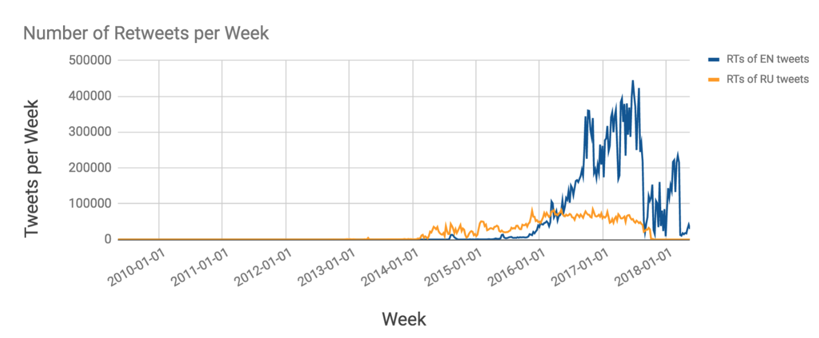
Retweet count over time by Language
https://medium.com/@katestarbird/a-first-glimpse-through-the-data-window-onto-the-internet-research-agencys-twitter-operations-d4f0eea3f566

Slide 23
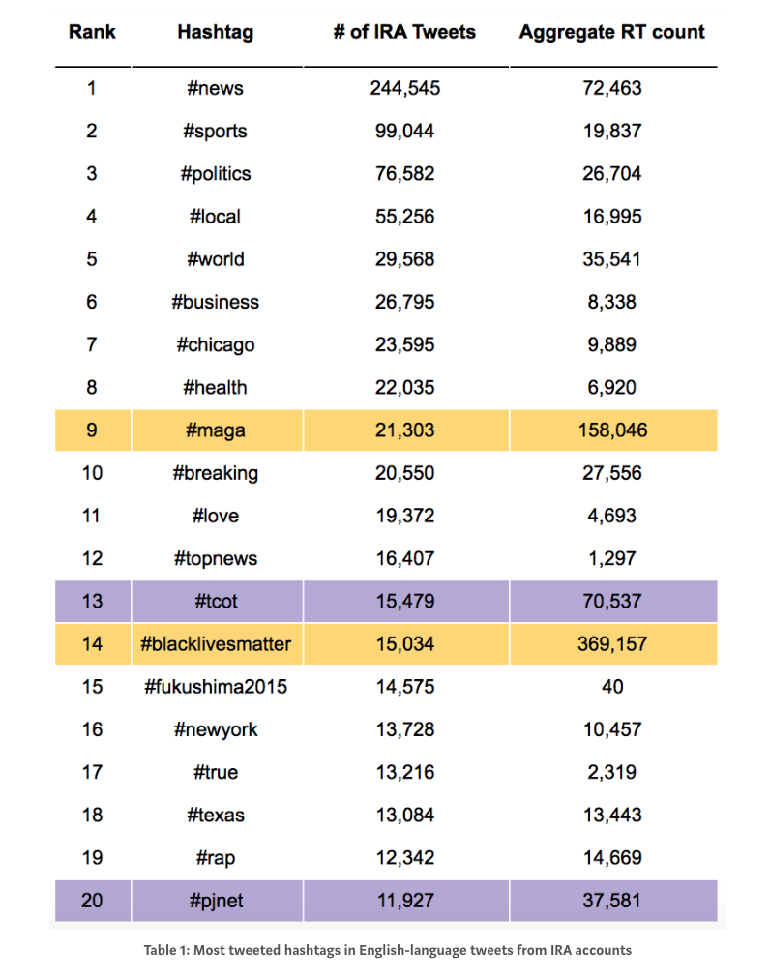
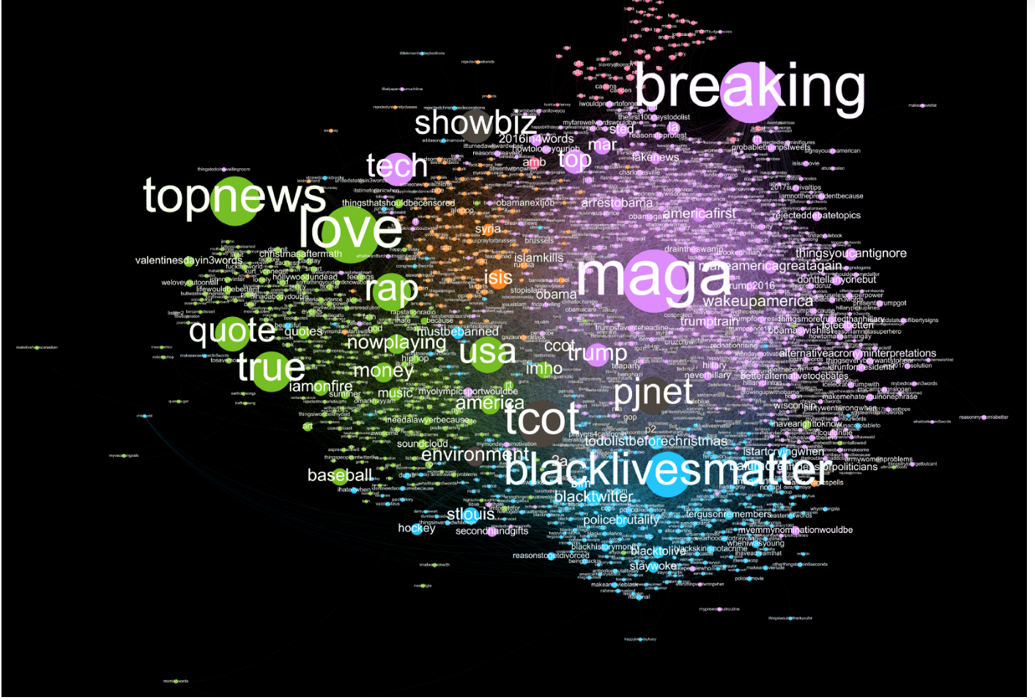
Most tweeted hashtags and their analysis:
Co-Occurring Hashtag Network Graph
Co-Occurring Hashtag Network Graph
https://medium.com/@katestarbird/a-first-glimpse-through-the-data-window-onto-the-internet-research-agencys-twitter-operations-d4f0eea3f566

Slide 24
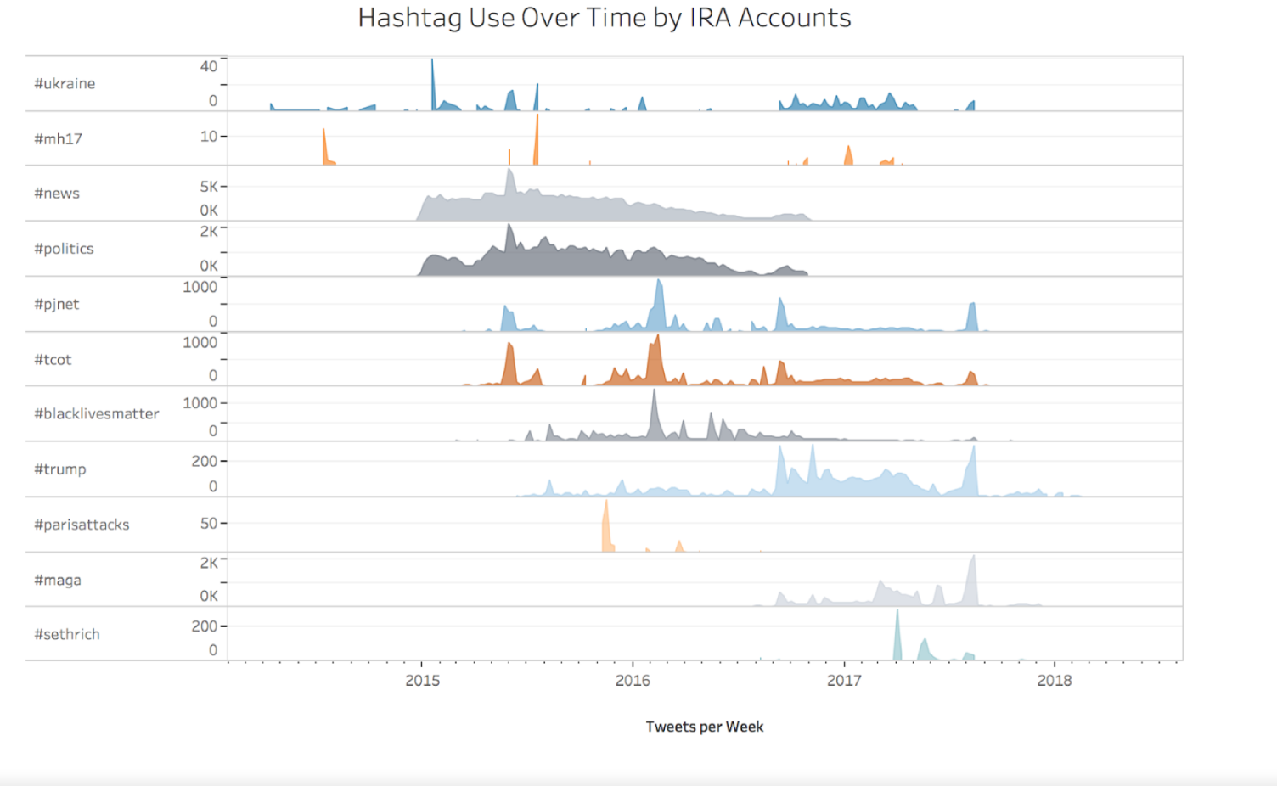
Tweets over a time for specific areas
https://medium.com/@katestarbird/a-first-glimpse-through-the-data-window-onto-the-internet-research-agencys-twitter-operations-d4f0eea3f566

Slide 25
Take Away:
Availability of the twitter data set will help diverse perspectives and methods of analysis
Enacting these personas in above way, the IRA agents shape ideas around online behavior in these politically active environments.
Analysis using network graph provides the overview of strategies of IRA accounts.
https://medium.com/s/story/the-trolls-within-how-russian-information-operations-infiltrated-online-communities-691fb969b9e4

